Slide 1
Lift45 and HR/Splats Customer Sentiment Analysis
Jeanie Liu, July 2023

Slide 2
Agenda
Lift45 - Customer Sentiment
Lift45 – Potential Solutions
HR/Splats – Customer Sentiment
1
台灣百貨業特色與趨勢
HR/Splats – Potential Solutions
2
Overall Recommendations
3
4
5

Slide 3
Lift45 – Customer Sentiment

Slide 4
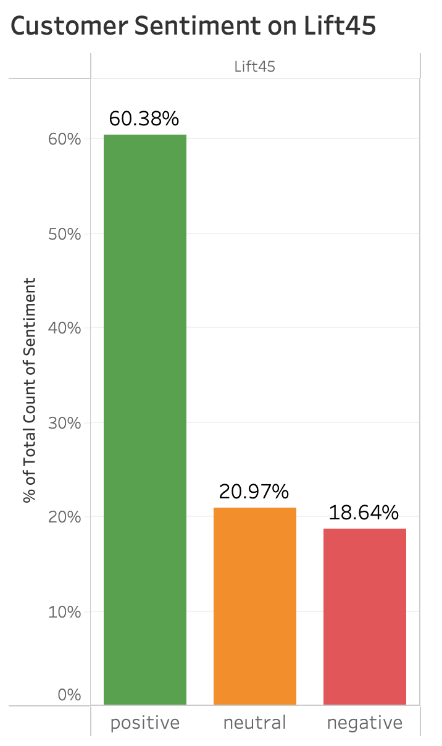
According to Reddit, over 60% of members have a positive sentiment on Lift45

Slide 5
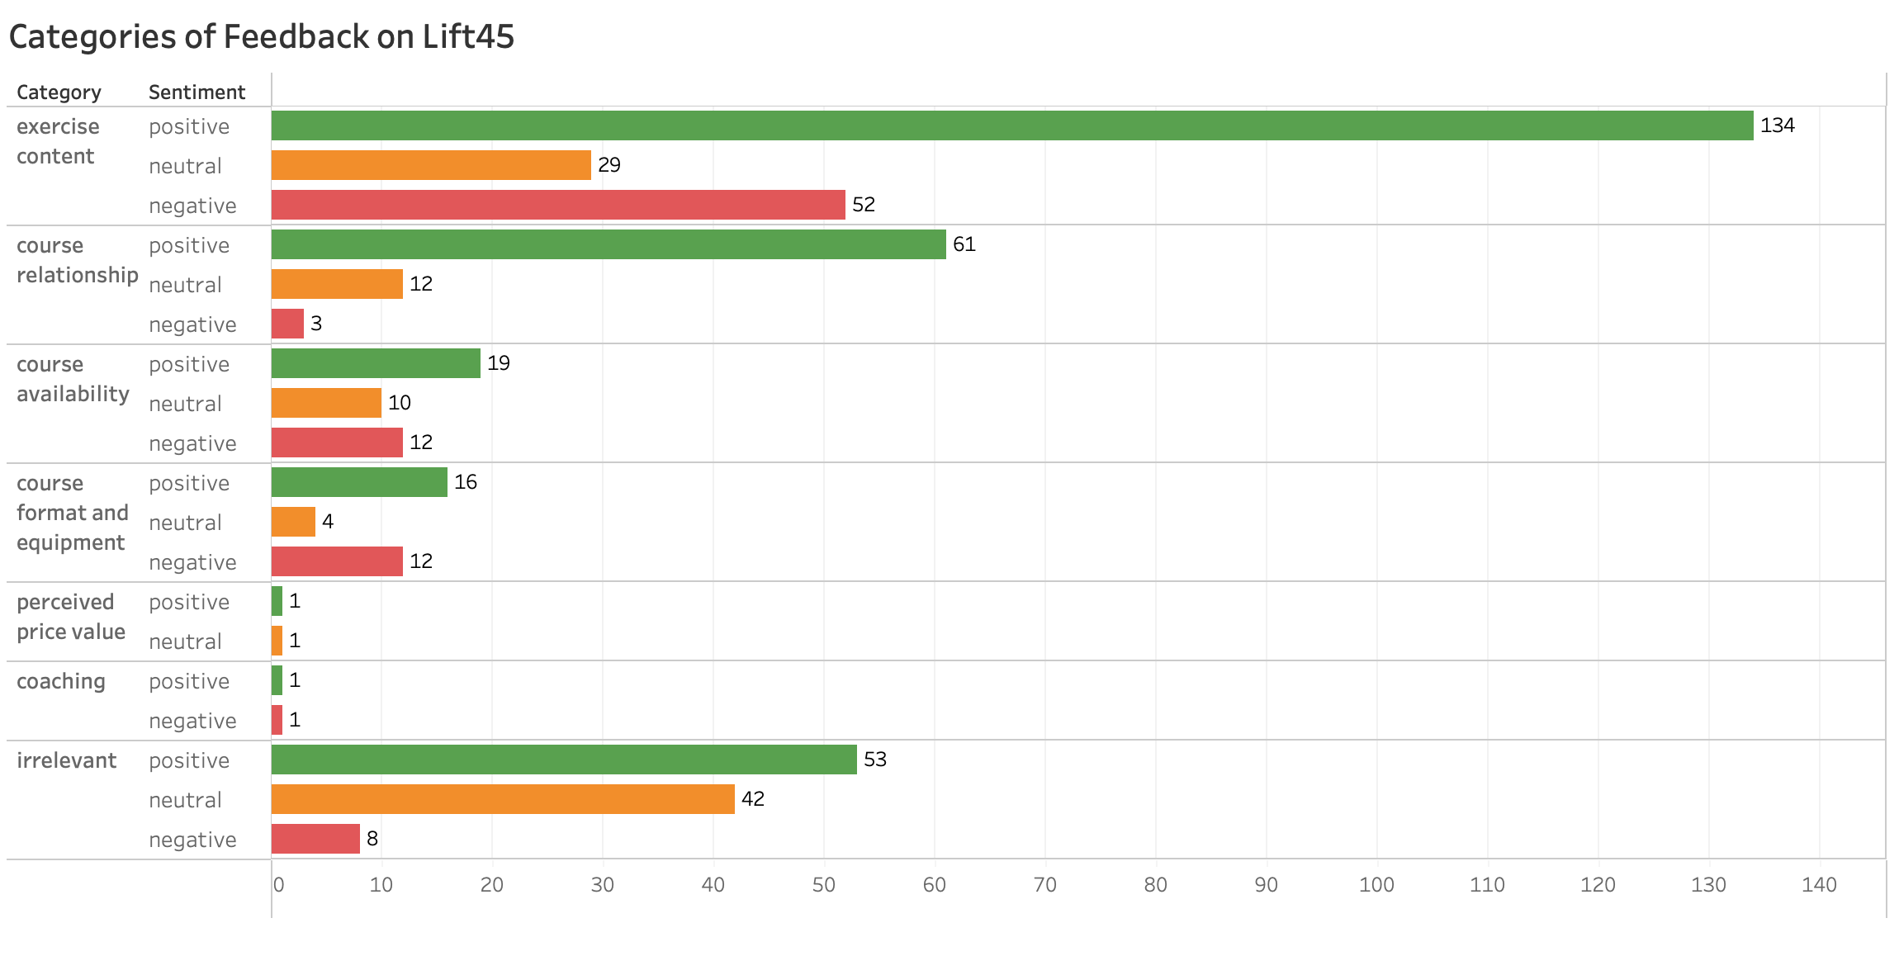
Many enjoy the exercise content of Lift45 and pairing it with Orange 60, but some dislike the exercise content, course availability, and course format and equipment

Slide 6




Enjoy templates with longer blocks
“I enjoyed the 30 min block because it made it easier to go slow and lift heavy.”
“I imagine the 30 minute block allows the coach to stress less about the template and they can move around watching everyones form.”
“Yoooo this template KICKED MY A$$!!! I got 24 splats and I never go for splats in a Lift, I usually stay in green!”
Reddit, 7/17/2023
Reddit, 7/18/2023
Reddit, 7/19/2023

Slide 7


Love focus on strength training
“I LOVE it. My goals are now more in strength training, building muscle, especially as a woman 45y/o +.”
“It was a game changer- my body felt muscles it hasnt felt in forever! I loved it.”
“I started adding lift classes about a year ago, and that is when I finally started to notice more muscle definition. I got guns now, baby!”
Reddit, 6/8/2023
Reddit, 6/17/2023
Reddit, 6/18/2023

Slide 8



Often pair Lift45 with Orange 60
”I think they are a great supplement after the regular 60 minute! Especially because you only lift for about 15-20 mins in a 3G.”
“I love doing lifts and then a 60 Monday mornings, best way to start the week!”
“I do this every Sunday too! I like the cardio between lifting.”
Facebook, 6/19/2023
Reddit, 7/11/2023
Reddit, 7/22/2023

Slide 9




Lift45 classes aren’t available enough
“I'd upgrade my membership if they added more.”
“I love it! But they are moving the Lift classes to nonpeak times so I won't be able to attend any. I may switch to another gym due to this.”
“Love Lift45 but I can never get into the darned classes at my studio. They fill up quick!”
Reddit ,7/6/2023
Facebook, 7/7/2023
Facebook, 7/8/2023

Slide 10


Inadequate space and weights
“Ive been to studios where its a 2G and sometimes you are really scrambling for the weights you need or you end up going lighted/heavier than you want.”
“With 16 people in the class it was impossible to get the weights I needed. Ended up just leaving 10m into the class and going to my normal gym. No more lift classes for me.”
“They really need to get bigger locations and have an extra two weight rack. Also fix the weight holders so they arent death claws waiting to cut your fingers.”
Reddit ,7/9/2023
Reddit, 7/23/2023
Reddit, 7/23/2023

Slide 11

Detest cardio in Lift45
“I take the lift class to LIFT! Lift class should not have cardio moves if I wanted cardio I would have gone to a 2G.”
“I like it the way it is but would love it if they got rid of classes with jumping and focused solely on strength training. A Lift60 would awesome!”
“Hopefully they will stick with the STRENGTH theme! Nothing makes me more mad than when I go to a Lift45 and its an endurance type template, or there are jumping movements.”
Reddit, 6/19/2023
Reddit, 6/22/2023
Reddit, 7/6/2023

Slide 12



Frustration with splat points from Lift45
“its frustrating when the coach says everyones in the green/ orange and I look up and Im in the grey/blue.”
“Coach here! Lift classes are not designed for splats— splats are for cardio!”
“I dont wear my monitor for lift classes because it lowers my max HR.”
Reddit, 6/9/2023
Facebook, 7/20/2023
Facebook, 7/22/2023

Slide 13



Outlook: Perception of Strength50
“Who misses when the classes were broken down by muscle groups? I like lift but I wish it were back to the original schedule so Id know what Im getting.”
“Prior to the change, the one lift class I can sometimes work into my schedule was always lower body. Going back to that would decrease my chances of wanting to go some weeks.”
“But I'm super stoked at the possibility of so many templates each week!!!”
Reddit, 6/22/2023
Reddit, 6/22/2023
Reddit, 7/6/2023

Slide 14
Lift45 – Potential Solutions

Slide 15
Things to keep in Lift45
Keep templates with long blocks (30 min) so that members can focus on lifting slow and heavy while coaches correct form
Continue to ensure there are Orange 60 classes right before and after Lift45 classes

Slide 16



Things to change in Lift45
Remove cardio moves from Lift45 (many agree with high consensus)
Limit class capacity and add more Lift45 classes at peak times to meet high demand, create a better class experience, satisfy members’ goal to gain strength, and prevent losing members
Don’t track splats for Lift45 by default, but give members the choice to track splats in the app if desired

Slide 17

Strength50 Recommendations
Continue with the plan to have many templates each week
Continue with the plan to have focused muscle groups on different days
Ensure the same day of the week has a different muscle group focus each week (e.g. Don’t make Fridays always upper body)

Slide 18
HR/Splats – Customer Sentiment

Slide 19
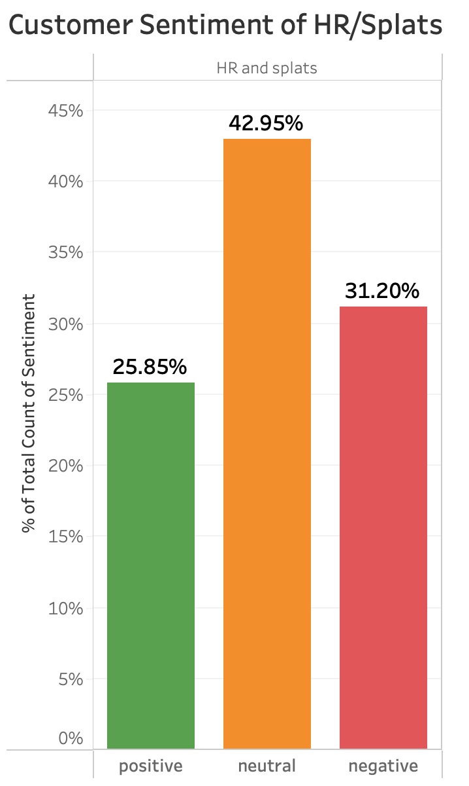
According to Reddit, over 30% of members have a negative sentiment on heart rate zones and Splat points

Slide 20
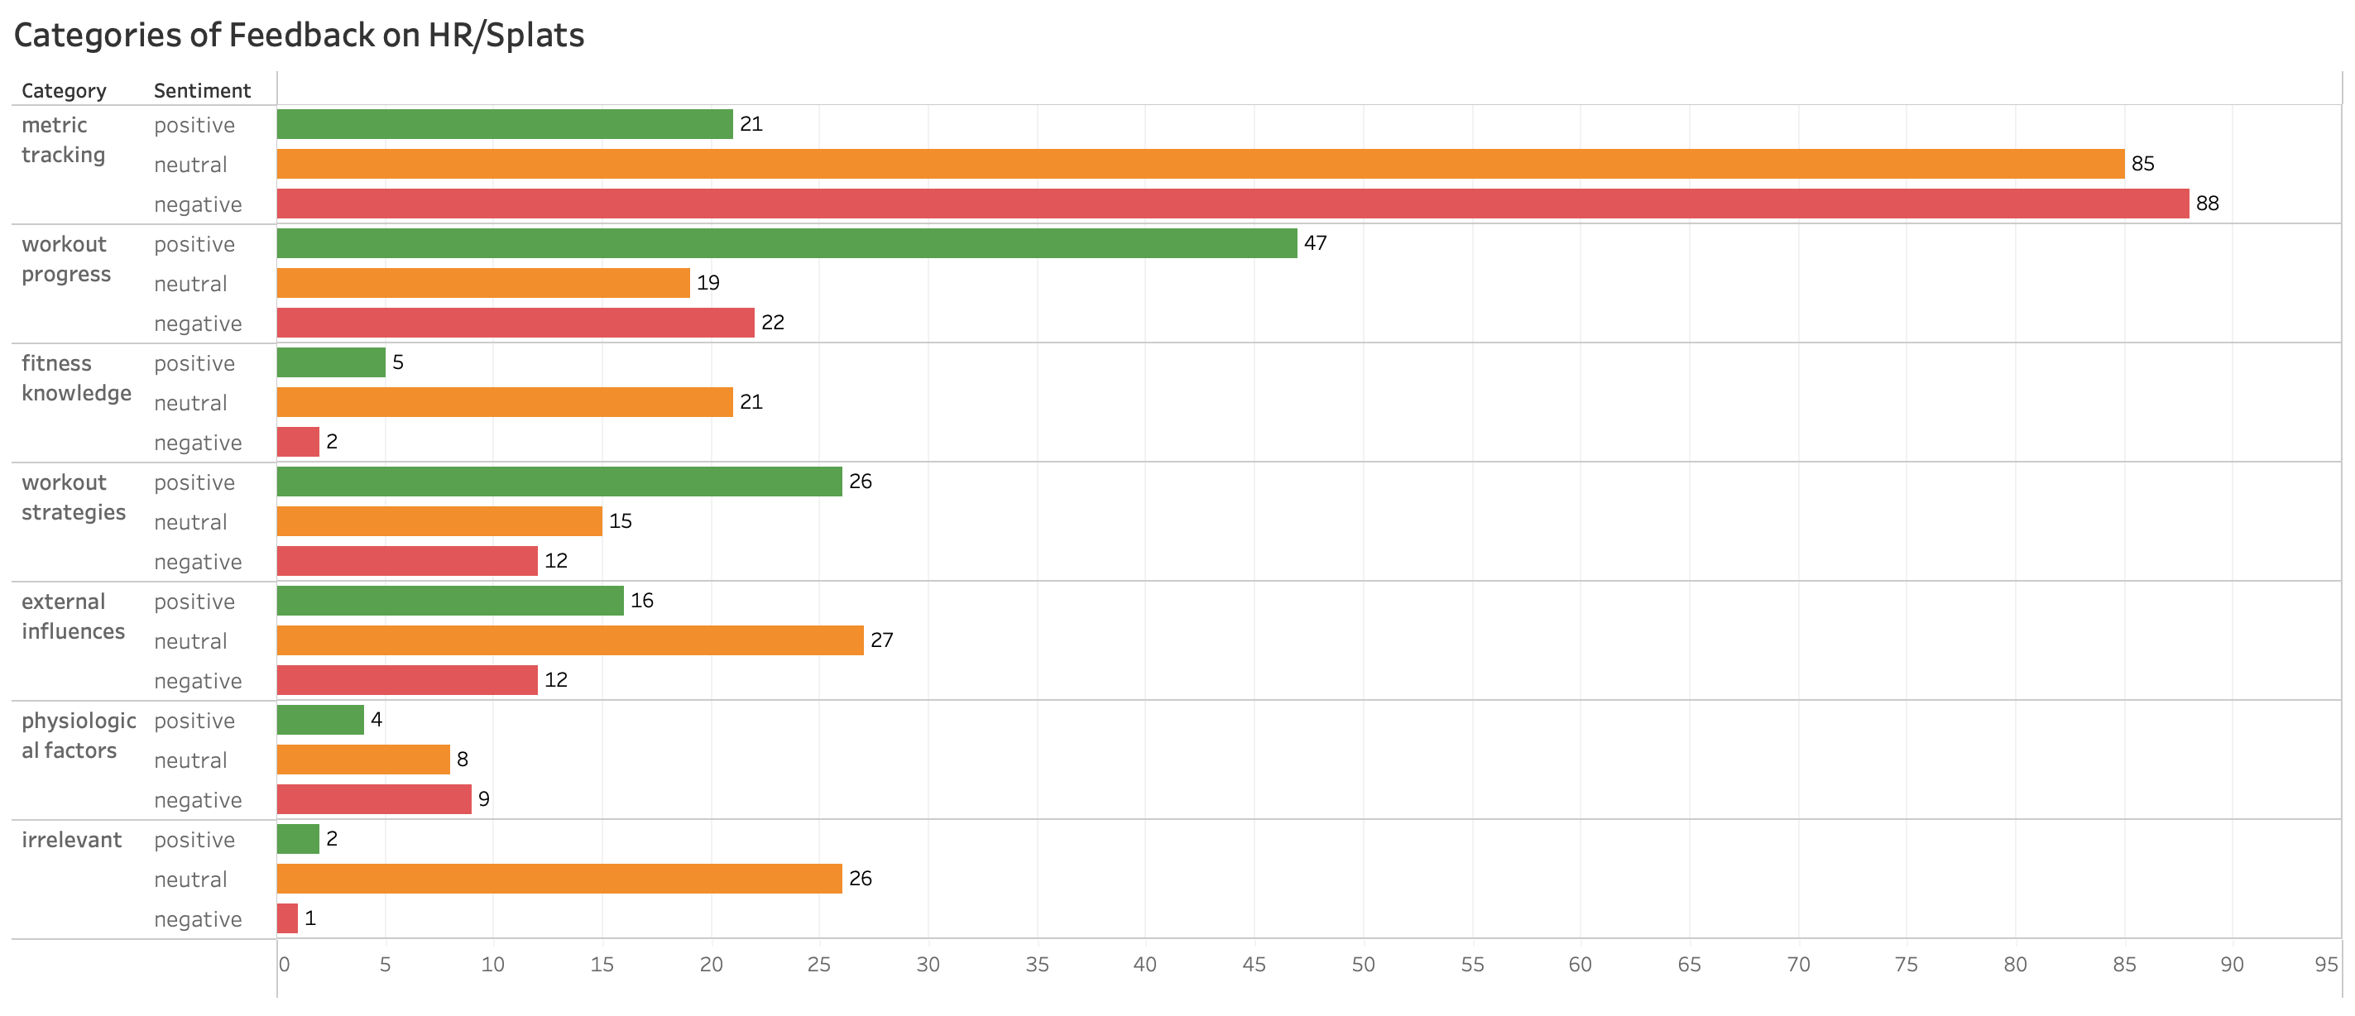
Although many are frustrated with how Orangetheory sets max HR and the difficulty to earn splats, many still find splat points a motivator and share their progress and strategies to stay in the orange zone

Slide 21

Motivation to earn splats
“1250 Classes! …and, exactly 15,000 splats!
[Equates to a perfect 12.0 splats per class]”
“My goodness, what a workout today, 40 splats to get the calorie burn!”
“You can never get too many splat points, it just means you worked hard”
Facebook, 5/4/2023
Facebook, 6/30/2023
Reddit, 7/5/2023

Slide 22


Workout strategies to earn splats
“Once you feel like you’re at your max hold on a little longer, push a little harder, get in one more rep.”
“I also make sure to use proper form on row which is usually slower but with more leg power.”
“I have realized that I get the most splats overall when I start on the treads. My splats drop off some when I start on the rower in a 3G, and drastically when I start on the floor.”
Facebook, 6/23/2023
Facebook, 6/23/2023
Reddit, 7/22/2023

Slide 23

Frustration over earning splats
“I be feeling like I am at my max already and my splat points are low.”
“When Im on the rower my heart rate monitor is always in gray and I feel like Im in orange.”
"Trying to go more by my feeling than the zone color, but the zones are part of why I pay for otf so its all kind of silly. Its a struggle to even get to low orange, so I know it’s off.”
Facebook, 6/23/2023
Reddit, 7/1/2023
Reddit, 7/19/2023

Slide 24
Dissatisfaction with metric equipment and algorithms
“Armband HRMs are notoriously finicky on rowers. Even with a properly relaxed grip and optimal placement, they can struggle to get an accurate reading.”
“I go to class quite a bit and my MaxHR hasnt moved a single beat in a year (thats probably 200+ classes”
“Now even with the adaptive algorithm I still get plenty of 0’s.”
Reddit, 7/2/2023
Reddit, 7/17/2023
Reddit, 7/21/2023

Slide 25


Difficulty in adjusting max HR
“I was told they will not adjust to a lower rate. “
“Dont understand why OTF cant simply adjust HR at a members request w/o an on-line marathon. We’re adults paying good $ for membership - if we want to adjust our MaxHR, the only acceptable answer is yes.”
“I had to send a message in app support to force mine to update. And its still off, but closer to accurate now. I wish they would leave it alone.”
Reddit, 7/1/2023
Reddit, 7/2/2023
Reddit, 7/7/2023

Slide 26



Resulting in: Poor perception of splats
“I noticed that people who attend OTF regularly get fewer splats.”
“Higher splats is not the goal. It's actually an indication of poor conditioning.”
“the benefits of exercising aren't dependent on how many 'splats' you get.”
Facebook, 6/23/2023
Facebook, 6/23/2023
Reddit, 7/22/2023

Slide 27
HR/Splats – Potential Solutions

Slide 28


HR/Splats Recommendations
Allow the members to adjust their max HR if desired to induce positive reinforcement of exercising with splats instead of inducing frustration and disappointment
Modify the algorithm so that auto adjustments to max HR are made regularly and are not raised to unreachable levels
Develop chest straps for monitoring heart rates to reduce inaccuracies

Slide 29
Overall Recommendations

Slide 30


Overall Recommendations
Educate members with fitness knowledge on the benefits of exercise and recognize the role that diet and physiological factors play in calories burned
Provide comparative metrics (e.g., calories) from members with similar height, weight, gender, and age.
Provide frequent training to individual locations’ staff and coaches to ensure consistency in policy enforcement and class quality across locations

Slide 31
Thank you for listening!

